Slide 1
AWS Compute

Slide 2
What is EC2?
Amazon Elastic Compute Cloud (Amazon EC2) provides scalable computing capacity in the Amazon Web Services (AWS) cloud.
It provides you with complete control of your computing resources and lets you run on Amazon’s proven computing environment.
Amazon EC2 reduces the time required to obtain and boot new server instances (EC2 instances) to minutes.
Amazon EC2 changes the economics of computing by allowing you to pay only for capacity that you actually use
Amazon EC2

Slide 3
AWS EC2: Benefits
Elastic
Web-Scale Computing
Completely Controlled
Flexible
Cloud Hosting Services
Integrated
Reliable
Secure
Inexpensive

Slide 4
AWS EC2: Features
Instances
AMI
Instance Types
Key
Pair
Instance Store
EBS Volumes
VPC
Security
Group
EIP
Tags
Regions
&
AZs

Slide 5
AWS EC2: How to access EC2
Web-based User Interface
Command Line Interface (CLI)
Windows PowerShell

Slide 6
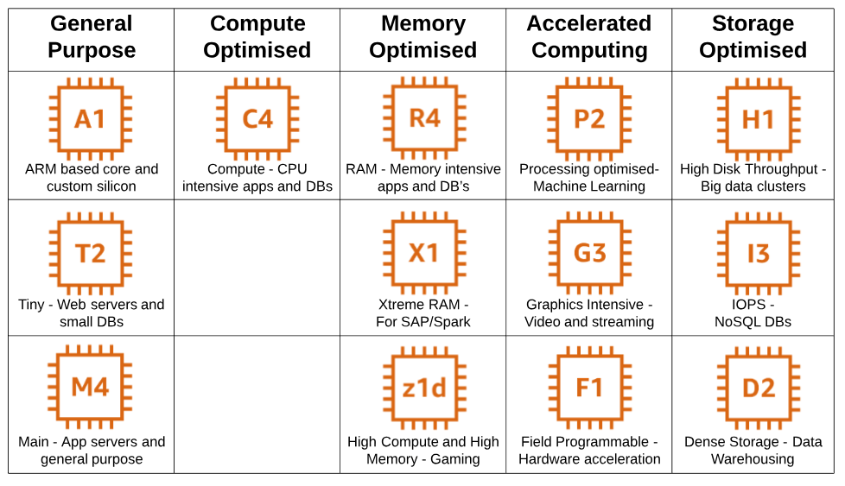
AWS EC2: Instance Types

Slide 7








AWS EC2: Purchasing Options
On-Demand
Instances
Reserved
Instances
Spot
Instances
Dedicated
Instance
Dedicated
Hosts
Purchase at significant discount (up to 75%).
Instances are always available
Physical host is fully dedicated to run your instances.
Bring your per-socket, per-core, or per- VM software licenses to reduce cost.
Highest bidder uses instance at a significant discount
(up to 90%)
Spot blocks supported
Pay, by the
hour, for
instances that
run on single tenant
hardware
Pay by the hour
1-year to 3
year terms

Slide 8
EC2 Tenancy
Shared Tenancy:
The default tenancy model is the one most commonly used with AWS.
Multiple customers will share the same pieces of hardware even though they don’t interact with each other.
Option to use unless you have regulatory compliance or licensing restrictions causing you to pick a dedicated model.
Cheapest option for running your EC2 instances.
Dedicated Instance
Dedicated tenancy ensures that your EC2 instances are run on hardware specific to your account but comes at a price.
Regulatory compliance may dictate that you want to use this model
Costlier than Shared Instances Model
Dedicated Hosts
With a dedicated host, you purchase an entire physical host from AWS and that host is billed to you on an hourly basis just like EC2 instances are billed.
Once you’ve purchased that host, you’re allowed to spin up as many EC2 instances as that host will allow for no additional charges.
Customers can buy license of the host
Dedicated hosts is highly compliant and is the costliest among all the tenancies.

Slide 9
AWS EC2: Reboot, Stop, and Terminate
Characteristic | Reboot | Stop/start (EBS- backed instances only) | Terminate
Host computer | The instance stays on the same host computer | The instance runs on a new host computer | None
Private and public IPv4 addresses | These addresses stay the same | The instance keeps its private IPv4 address. The instance gets a new public IPv4 address | None
Elastic IP addresses (IPv4) | The Elastic IP remains associated with the instance | The Elastic IP remains associated with the instance | The Elastic IP is disassociated from the instance
Instance store Volumes | The data is preserved | The data is erased | The data is erased
Root device volume | The volume is preserved | The volume is preserved | The volume is deleted by default
Billing | The instance billing hour doesn't change. | You stop incurring charges for an instance as soon as its state changes to stopping. Each time an instance transitions from stopped to running, it start a new instance billing hour | You stop incurring charges for an instance as soon as its state changes to shutting-down

Slide 10
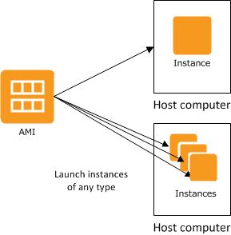
AWS EC2: Amazon Machine Images
An Amazon Machine Image (AMI) provides the information required to launch an instance.
An AMI includes the following:
A template for the root volume for the instance (for example, an operating system, an application server, and applications)
Launch permissions that control which AWS accounts can use the AMI to launch instances
A block device mapping that speciﬁes the volumes to attach to the instance when it's launched.

Slide 11
AWS EC2: Storage for the Root Device
Characteristic | EBS Backed | Instance-Store Backed
Boot Time | Usually < 1 minute | Usually < 5 minutes
Size Limit | 16 TiB | 10 GiB
Data Persistence | The root volume is deleted when the instance terminates or EBS volumes persists after instance termination | Data on any instance store volumes persists only during the life of the instance
Charges | Instance usage EBS volume usage Storing your AMI as an EBS snapshot | Instance usage Storing AMI in S3
Stopped State | Can be stopped | Cannot be stopped

Slide 12
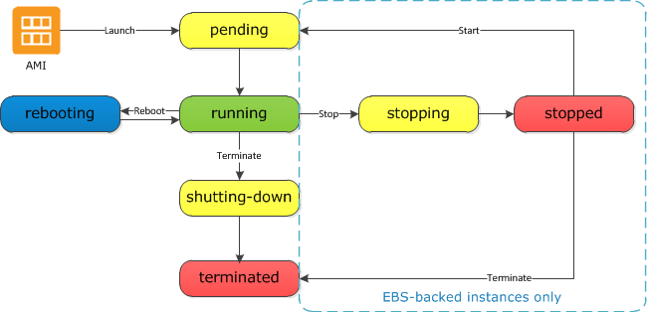
AWS EC2: Instance Lifecycle

Slide 13
Session Manager & EC2 Instance Connect
EC2 Instance Connect and Session Manager are features that let you connect to your EC2 through browser
No need to provision RSA Keys
EC2 Instance Connect does not require a IAM role where as Session Manager requires an IAM role
No security group required for Session Manager , but EC2 instance depends on Security Group.

Slide 14
AWS EC2: Resizing
If the root device for your instance is an EBS volume, you can change the size of the instance simply by changing its instance type, which is known as resizing.
You must stop your Amazon EBS–backed instance before you can change its instance type.
After resizing, the instance ID does not change.
If instance has a public IPv4 address, AWS release the address and give it a new public IPv4 address.
The instance retains its private IPv4 addresses, any Elastic IP addresses.

Slide 15
AWS EC2: Instance Termination
After you terminate an instance, it remains visible in the console for a short while, and then the entry is automatically deleted.
By default, Amazon EBS root device volumes are automatically deleted when the instance terminates.
By default, any additional EBS volumes that you attach at launch, or any EBS volumes that you attach to an existing instance persist even after the instance terminates.
If you want to prevent your instance from being accidentally terminated using Amazon EC2, you can enable termination protection for the instance

Slide 16
AWS EC2: Elastic IP
An Elastic IP address is a public IP address (static) that you can allocate to instance.
You can disassociate an Elastic IP address from a resource, and re-associate it with a diﬀerent resource.
A disassociated Elastic IP address remains allocated to your account until you explicitly release it.
To ensure efficient use of Elastic IP addresses, a hourly charge is associated if an Elastic IP address is not associated with a running instance, or if it is associated with a stopped instance or an unattached network interface.
You are not charged for one Elastic IP address associated with the running instance, but you are charged for any additional Elastic IP addresses associated with the instance.
By default, all AWS accounts are limited to 5 Elastic IP addresses per region.

Slide 17
AWS EC2: Elastic Network Interfaces
An elastic network interface is a virtual network interface that you can attach to an instance in a VPC.
You can create a network interface, attach it to an instance, detach it from an instance, and attach it to another instance.
Every instance has a default network interface, called the primary network interface (eth0). You cannot detach a primary network interface from an instance.
You can create and attach additional network interfaces. The maximum number of network interfaces that you can use varies by instance type.
A network interface can include the following attributes:
A primary private IP address & one or more secondary private IP addresses
One Elastic IP address per private IP address
One public IP address
One or more security groups
A MAC address

Slide 18
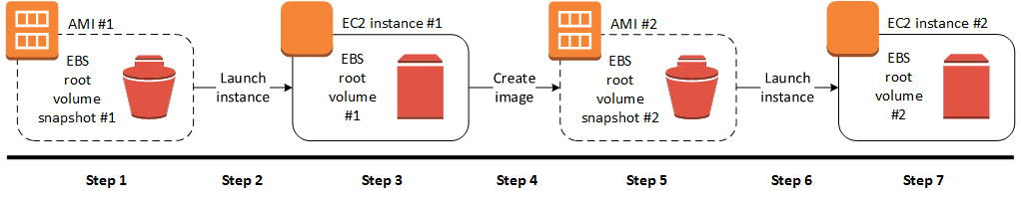
AWS EC2: Creating AMI or Custom AMI
Select an appropriate EBS-backed AMI
Launch an instance
Update an instance
Create image
Launch an instance from your new AMI

Slide 19
Placement Groups
Logical grouping of instances within a single Availability Zone Recommended for applications that benefits from low network latency, high network throughput, or both.
Cluster Placement group is a logical grouping of instances in a single Availability Zone.
Spread Placement group is a group of instances that are each placed on distinct underlying hardware.
Using placement groups enables applications to participate in a low latency, 10 Gbps network.
https://docs.aws.amazon.com/AWSEC2/latest/UserGuide/placement-groups.html

Slide 20
AWS EC2: Understanding EC2 Billing
If instance is billed by the hour, you are billed for a minimum of one hour each time a new instance is started—when it enters the running state.
If your instance is billed by the second, you are billed for a minimum of 60 seconds each time a new instance is started—when it enters the running state.
Instances that are in any other state—such as stopped, pending, etc.—are not billed.
Examples:
When you run one instance for 30 minutes and then terminate the instance, you are billed for one instance hour.
When you run one instance for 10 minutes, stop the instance, and then start the instance again, you are billed for two instance hours.
When you run two EC2 instances of the same type for 30 minutes each, you are billed for two instance hours.

Slide 21
AWS EC2: Per Second Billing
With per-second billing, you pay for only what you use.
EC2 usage are billed on one second increments, with a minimum of 60 seconds.
Per-second billing is available for instances launched in:
On-Demand, Reserved and Spot forms
All regions and Availability Zones
Amazon Linux and Ubuntu

Slide 22
Quiz
1. Which EC2 offering provides the information needed to launch an instance?
Bootstrap Action
Spot Fleet
CloudWatch
Amazon Machine Image
2 . Can I move a reserved instance from one region to another?
Yes
No
Depends on REgion
3. Amazon's EBS volumes are ________.
Object Based
Block Based
File based

Slide 23
Thank You

